Slide 1
Parametric distributions

Slide 2
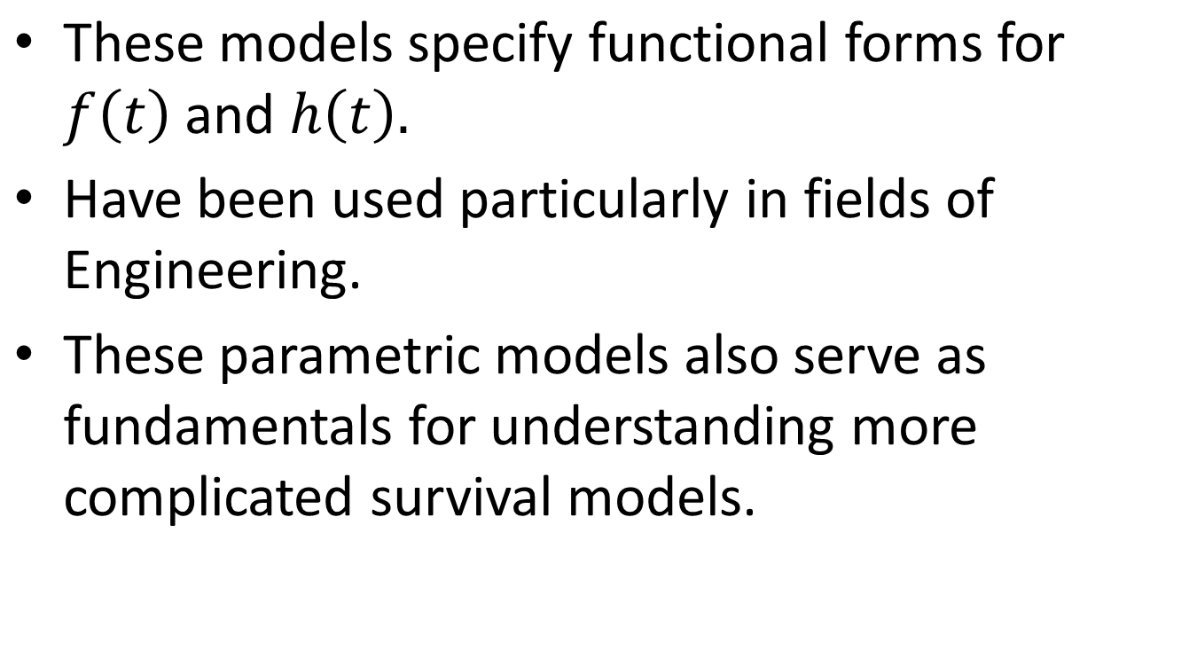
Parametric distributions
Notes:
In parametric models, we will specify function forms for the density function or the hazard function. In the lecture, we will focus on the functional forms or shapes for the hazard function.
Parametric models have been popular in feilds of engineering. Some of the models have been useIn the biomedical field, the data is more complicated, and often can not fit well by parametric models. One reason that we introduce these parameteric models is that it also serves as

Slide 3
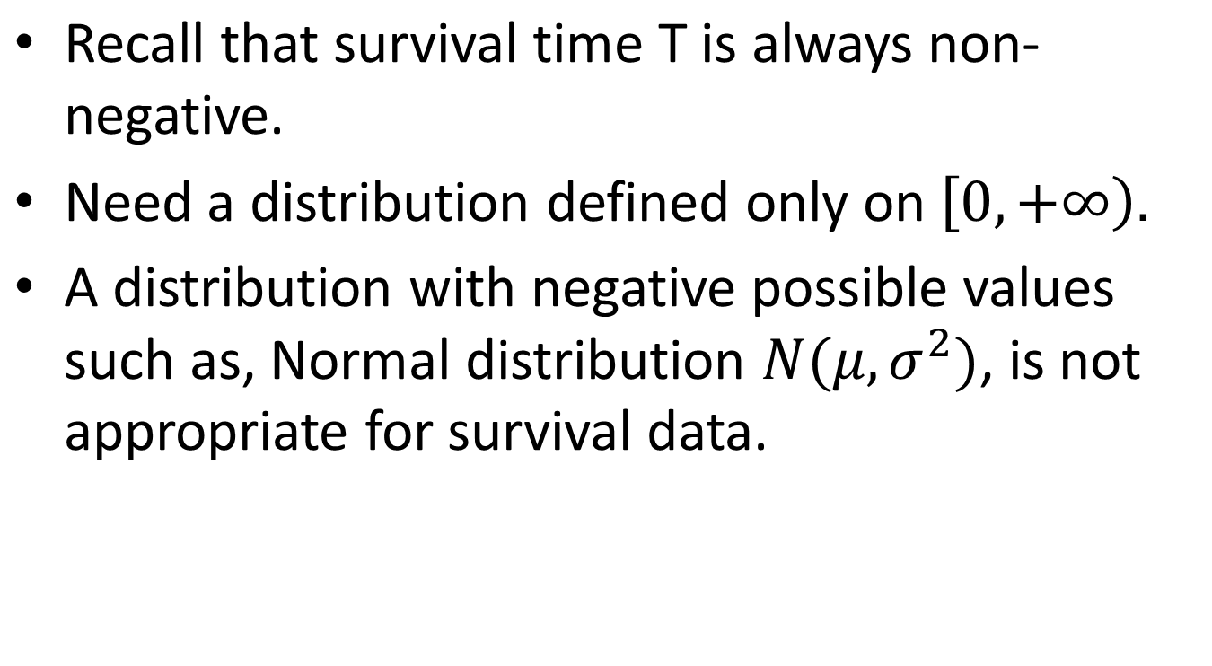
Parametric distributions

Slide 4
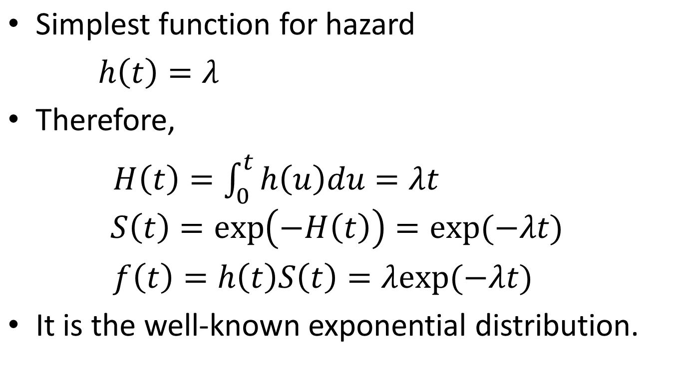
Exponential distribution
Notes:
Exponential distribution is the simplest model for survival data. A uinque feather of expoential distribution is that the hazard function is a constant over time. Or the conditinal simulatineous failure rate does not change over time. Exponetial distribuions specifies the simplest functional form for hazard function. Here the constant hazard rate lambda is parameter. In particular mean survial time=1/lambda. Based on the hazard function, we can then derive the following functional forms for the cumjlative, surival function and density function.

Slide 5
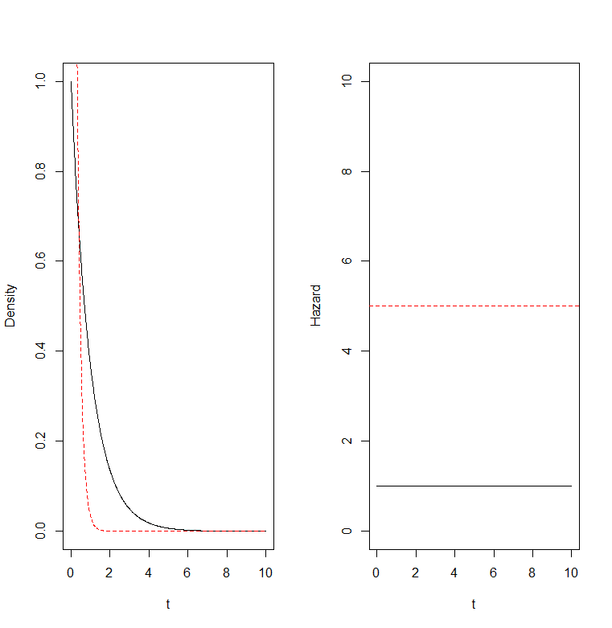
Notes:
In this figure, we plot the pdf and hazard function with two different choices of hazard rates. The pdf for an expensti decreases explentialy fast over time, while the hazard function is a costant, does not change over time

Slide 6
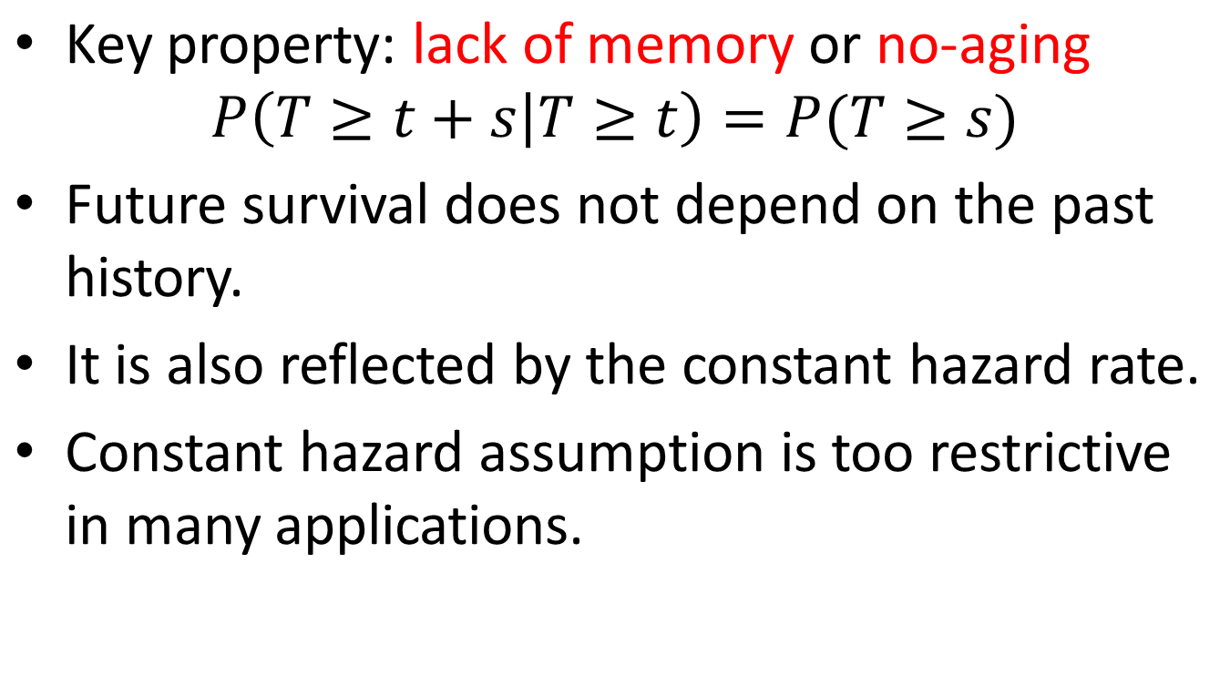
Exponential distribution
Notes:
A key properatie is...... Under expoential distributin, we have the probabiity of surivivaling addtional s years does not depend on how long you have surivived.
Probability for a light bulb to work additional s days doesn not dpends on how long it has been worked. A light bulb of 1 monght is as good a new one. So for expeonetial distibution, furture surival does not depend on the past history. This no-ageing property is also relfected by the constatn hazard rate. That The instantesnt failure rate does not depend on time, or depnds on how long you have surived.
Exponential distribution is useful when the occurrence of events is stable over time and does not distinctly associated with time. In practice, however mortality, incidence of disease, all seems highly associated with time or age. So this constant hazard assumptions is too restrive in many applications.

Slide 7
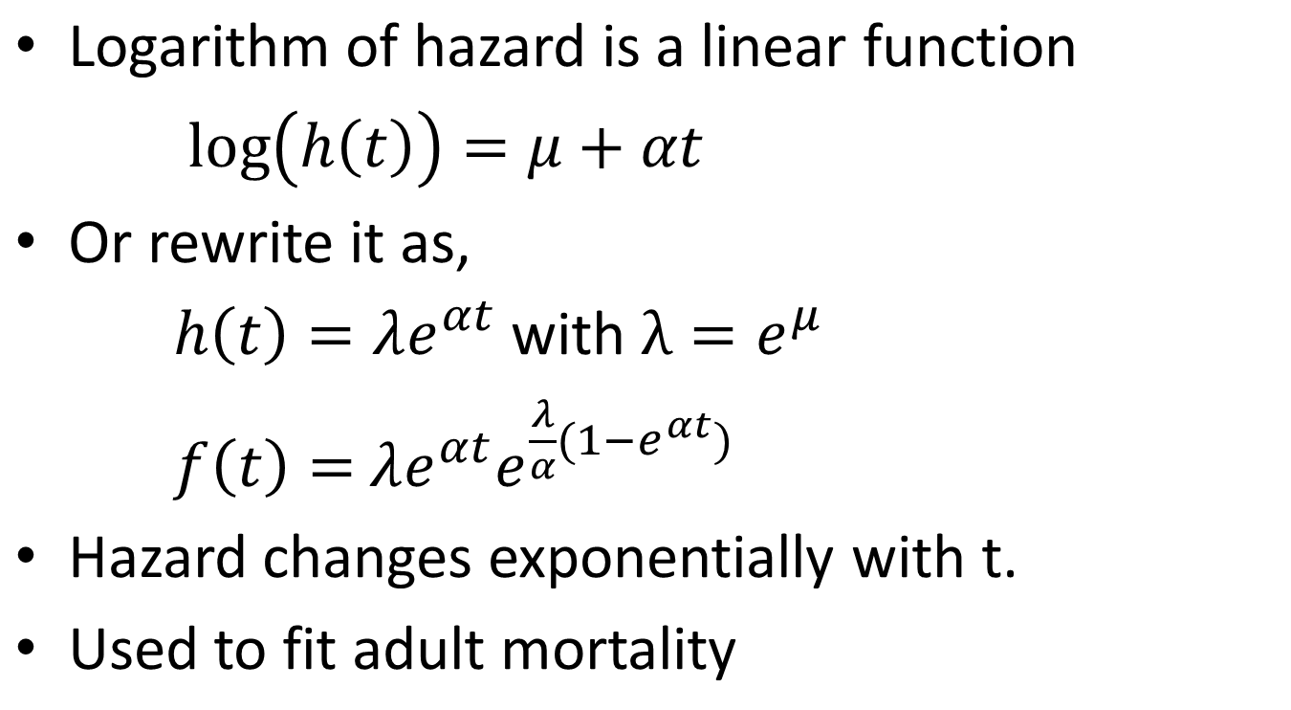
Gompertz distribution

Slide 8
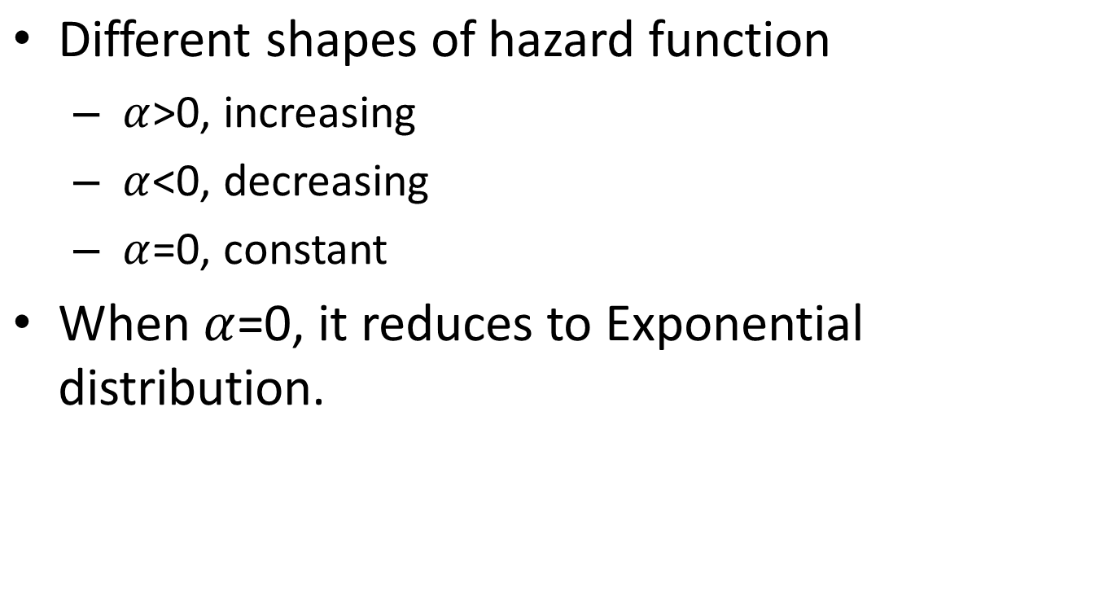
Gompertz distribution

Slide 9
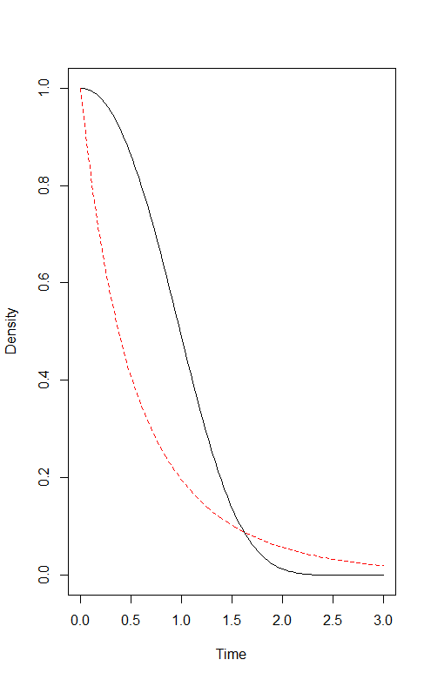
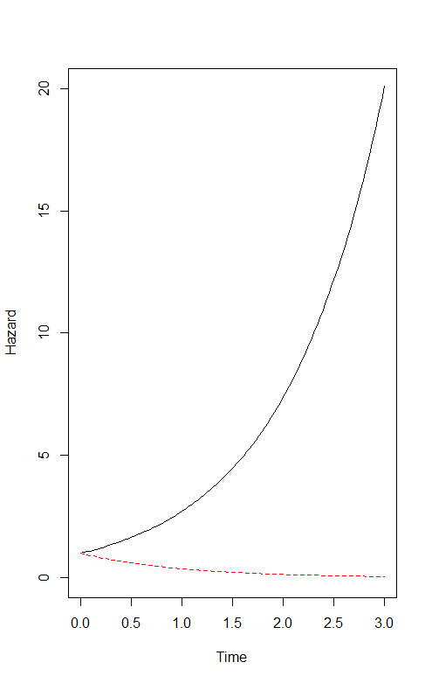
Gompertz distribution

Slide 10
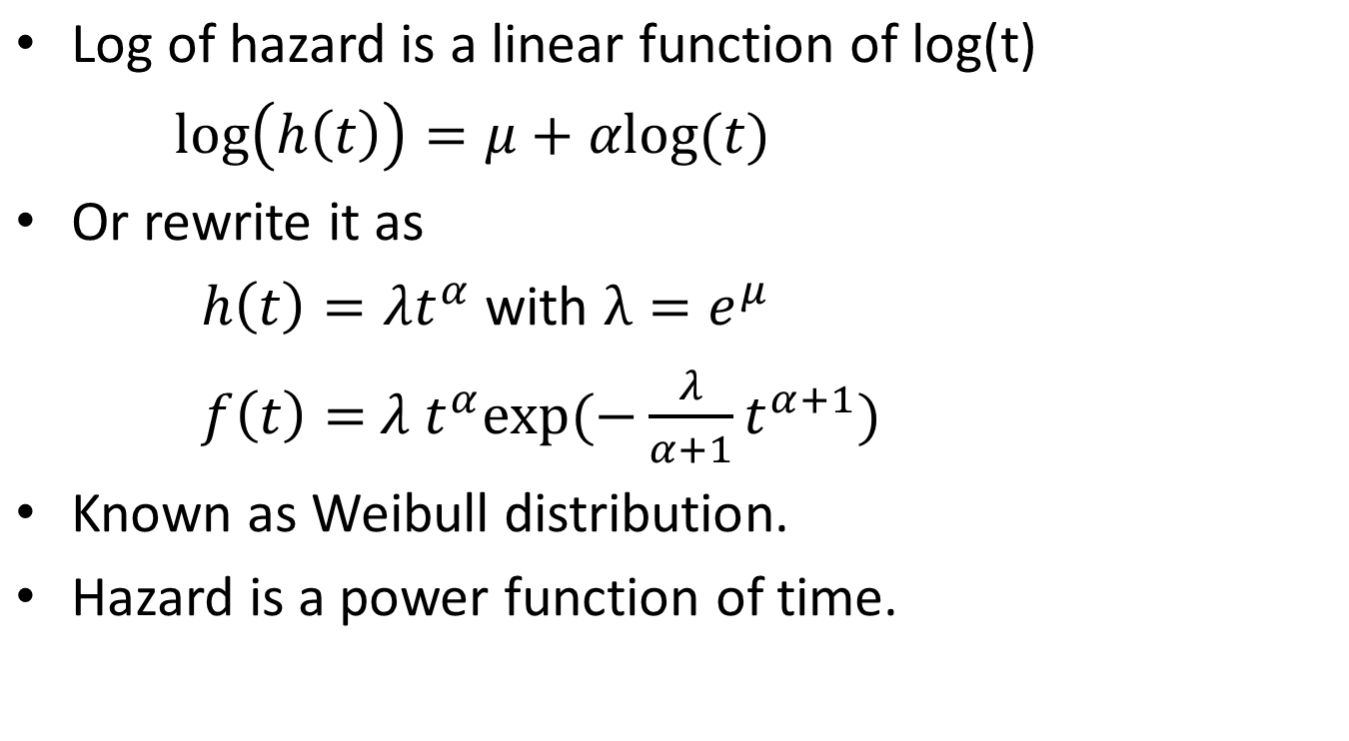
Weibull distribution

Slide 11
Weibull distribution

Slide 12
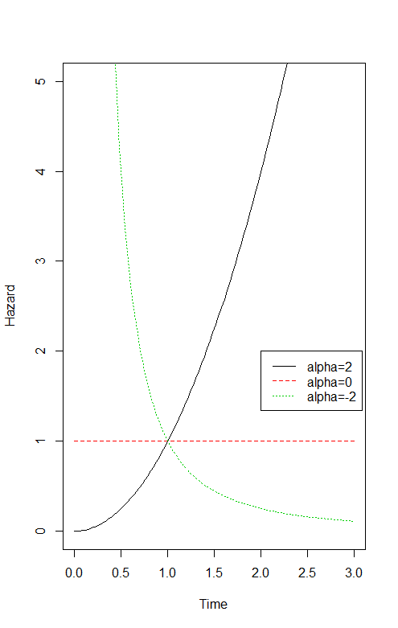
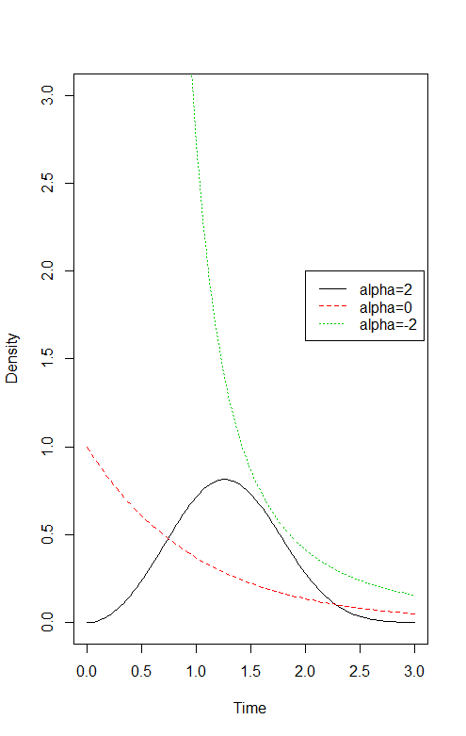
Weibull distribution

Slide 13
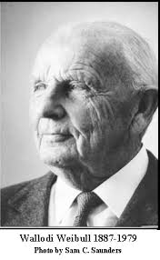
Weibull distribution
Invented by Waloddi Weibull in 1937

Slide 14
Weibull distribution
(From Wikipedia) Waloddi Weibull is a Swedish engineer, scientist and mathematician.
In 1951 he presented his most famous paper to the American Society of Mechanical Engineers (ASME) on Weibull distribution, using seven case studies.
He claimed that his distribution applied to a wide range of problems.
Today, it is still one of the most popular parametric model to model survival time.

Slide 15
Common parametric models
Exponential: constant hazard (memoryless)
Gompertz distribution: hazard change exponentially with t.
Weibull: power function of t (monotone increasing or decreasing)
Gamma: monotonic hazard (increasing or decreasing)
Log-normal: unimodal (first increase then decrease)
Log-logistic: monotone or unimodal
Notes:
In smummary, we have introcued several parameteri cmodel for surivla data. We have focused on the specify the shapes for the hazard function. For example, the simplicst model Expoential distirbution gives a constant hazard. And the Gompertz distribution gives monotone hazard. The hazard can be increasing or decreasing hazard with hazard rate changes expoentially with time t. The Weibull distirbuton also give montone increasing or decreasing hazard function, with hazard function being a power function of time. In additon to these parametric models, there are many other parametric distirbutons for survivial time and can give more complciated shapes of hazard function. For example, Gamma distribution is another popular distribution and it gives montonic hazard functin. and for the log-normal distribution, the hazard can be unimodal (first increase than decrease), and log-logitiscis more flexible can be motontoic or unimodal. For the other parametric models, please read the textbook for more details.

Slide 16
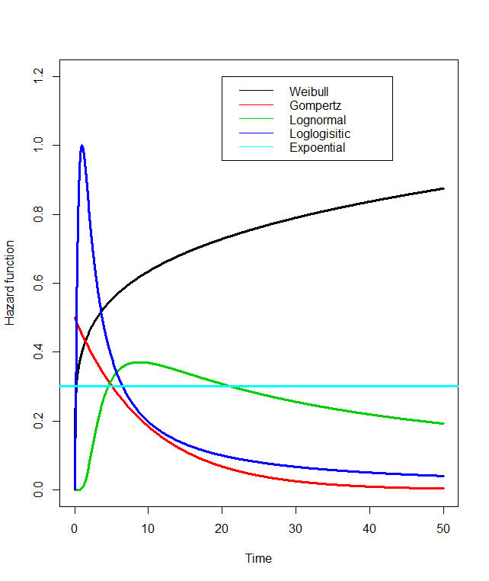
Common parametric models
Notes:
In this figure, we plot hazard functions from some parametric models. Different parametric models can give different shape of hazard function. For example, in this plot,
Knowing shapes of hazard function for the parametric distribution, can guide you pick appropriate parametric distribution to fit your data. For example, if you know the hazard function for your problem should be monotic , Then we can try to fit data with Weibull or Gompertz distributions. If the hazard of your problem is first increasing and dcerasing, then log-normal or log-logitic may be more appropriate.
For practical problems, often there is some prior infomration knowelge about how the hazard function might be shaped. Later we will introduce different parametric distributions for survival time. Knowing possible shapes for your practical problem can help you to pick appropriate parametric distribution.

